Slide 1
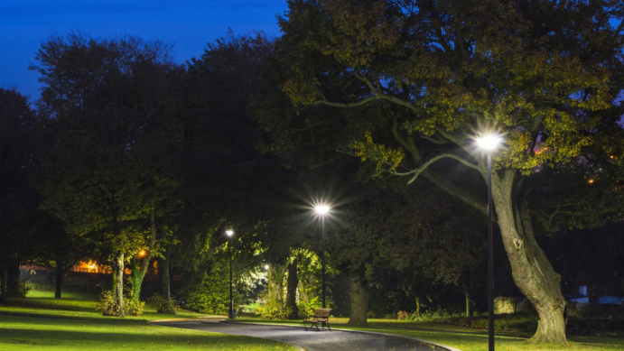
Control Systems - ECE2010 Review - III
SMART STREET LIGHT SYSTEM
Amsuri Srinivas Anand – 18BEC0567
VUYYURI NIKITH VARMA – 19BEC0658
FACULTY: DR.BAGUBALI A
SLOT:G2+TG2

Slide 2
Introduction
Now a days, the power consumption due to street lights is rising up. There are no people to monitor their activity, all night long and sometimes in the day time also we can see them ON itself. This is because it requires some man power to do, if the person ON the lights in the evening and went away then the lights would we be ON throughout the night and sometimes, even in the morning, if the person fails to OFF the lights they will glow in the morning too. So to solve this problem, we came up with the automatic street light system, which can reduce the power consumption efficiently.

Slide 3
Objective
The aim of this project is to present a basis of how to implement a Smart Street Light System. It will provide a way for anyone to implement a solution with low-budget hardware and reduce electricity and also reduces CO2 emission.

Slide 4
Abstract
The current street lights on our roads works on a manual On/Off system, due to which there is a lot of power consumption as the lights glow through out the night and would be off next day morning. So, to prevent this we can use the smart street light system. This system makes the light on only when necessary(i.e when a vehicle or any person is passing) and the light would remain off when no one or any vehicle is not passing. This helps in saving a lot of power, since it is automatic no man power would be required. In briefly the light will on when the light from the vehicle falls on the LDR or when an IR sensor detects the motion of any person, and it again goes off when the vehicle or a person passes away from it.

Slide 5
Hardware Requirement:
Software Requirement:
Wemos D1 R2
IR Sensor
LED
Bread Board
Resistor(1K)
LDR
Arduino IDE
ESP8266 Library
Visual Studio Code

Slide 6
Literature Survey
The establishment of smart street lights in India has brought a lot of change to the country. On October 7th, 2019, a total of 1 million that is 10Lakh smart street lights have been installed across the country, which is a huge milestone as it saves 6.71 billion Kilo Watts which is huge. It also reduces the emission of 4.6 million tons of carbon dioxide that too every year, also nearly 13,000 jobs have also been created because of this project.
LINK:
https://docs.google.com/document/d/1yN_rcZIkRlj9TRUQ93TkcVkPD4sPkVe4mL80GkXzWFA/edit?usp=sharing

Slide 7
Methodology
Here we are using the IR sensor to detect the motion of the person or any vehicle and an LDR is used to detect the intensity of sunlight and to make the light ON/OFF. So when sun sets in the evening, the intensity of light falling on LDR decreases and it’s resistance increases, which leads to turning the light ON and in the morning when the intensity of sunlight falling on LDR again increases then it’s resistance decreases and the light will be turned OFF. Basically it is used to ON the lights in the evening and again OFF them in the morning.
After turning ON the light in the evening, during the night when the people moving in the streets will be less or when there is no single person at that time that light gets OFF, when there is movement of a pedestrian or a vehicle within the range of the sensors, then the signals emitted by the sensor deflects back and gives an indication to the sensor to turn the lights ON. In this way we can save a lot of power consumption by the street lights.

Slide 9

Product development

Slide 10

Primary functions of smart street light system:

Slide 11
Existing Method:
Many places in India especially rural regions, still use sodium lamps and HID lamps on streets. These consume a lot of electricity and should be avoided at any cost. Now a days, LED are in trend and they are very efficient when compared to these traditional ones. LEDs consume less electricity and are easy to replace. But we still need an efficient way to organize these lights in order to reduce the power consumption as much as possible. Maintenance of these lights is very tiresome process. So, many people around have done some experiments and come up with very unique solutions to tackle these problems Maintenance and trying to reduce the power consumption using latest technologies can be implemented

Slide 12
Proposed Method:
Previously we have seen many techniques used by many researchers and companies to handle the problem of energy conservation with smart street lights. Not all ideas are efficient to implement in the current scenario, but we have some ideas as an inspiration and designed a technique of our own. The method we proposed depends on the communication of the lights or devices among themselves. Initially, the lights on the street are turned OFF.
When a person or a vehicle is approaching near the device, the light above the object is turned ON and the next light is also turned ON while keeping the first light ON, and the next light is kept ON irrespective of the movement of the object. When the person moves forward then the second light sends a signal to the next light for turning it ON and turning OFF the first light. All the lights communicate with each other using Wi-Fi. In this way 2 lights can be turned ON at a time providing enough vision for the person/object to move across the street. Switching ON two lights at once is convenient rather than turning ON one light when the person is under the light and switching it OFF when the person moves forward and consequently repeat this through the travel of the person/object. Continuous switching ON/OFF lights is very inefficient but it consumes electricity and can also decrease the life time of the street lights leading to frequent replacement. This proposed method can be used in real time applications. In our proposed we have selected a method where less energy is consumed by the lights even though LED consume less energy.

Slide 13
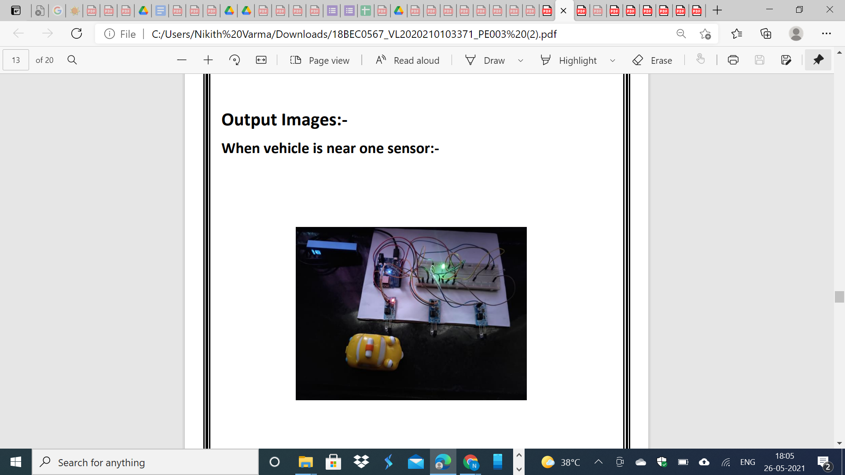

Slide 14
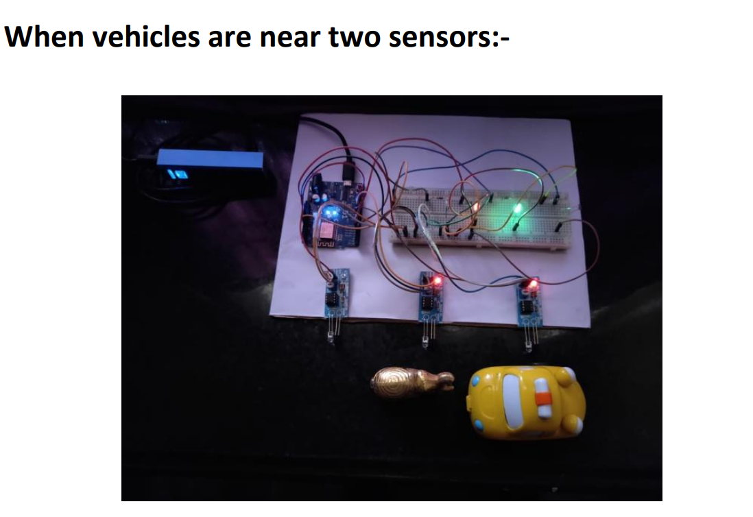

Slide 15
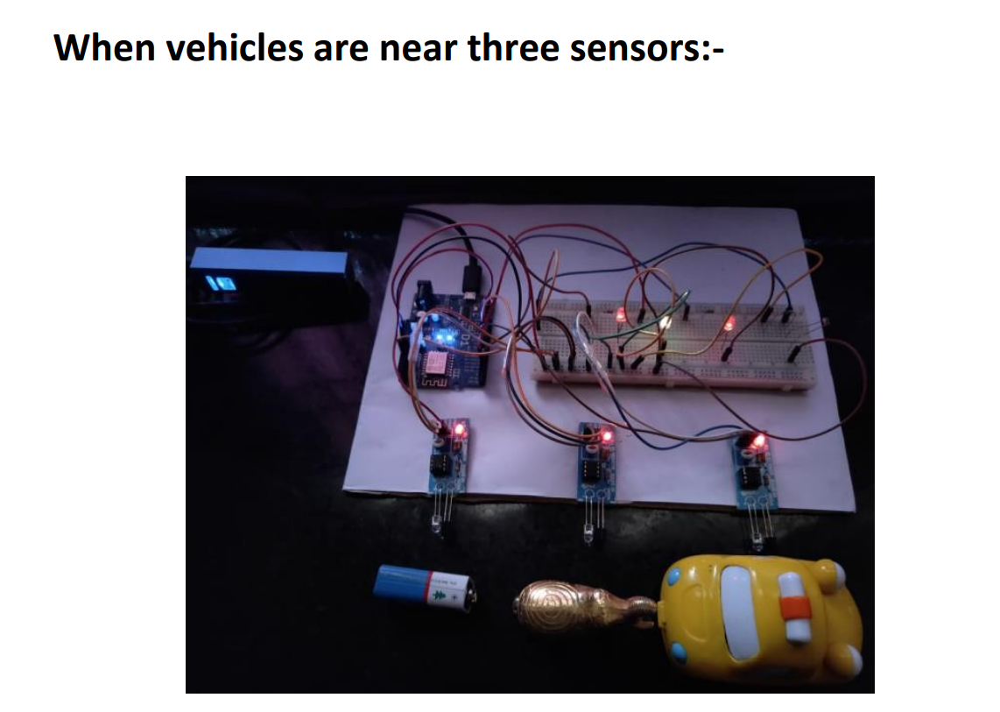

Slide 16
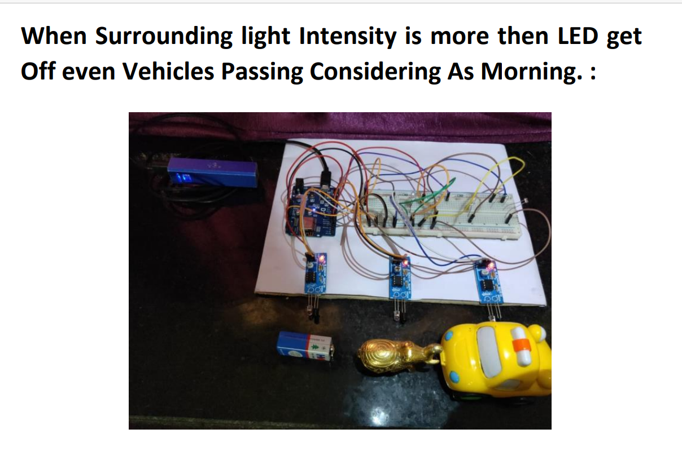

Slide 17


Slide 18


Slide 19


Slide 20


Slide 22


Slide 23


Slide 24
Results and Discussions:
The expected outcome for the software – hardware union is that the neighboring lights of the sensor which detects object should turn ON. That is taking 3 nodes into consideration, let them be Node A, Node B, and Node C. If there is an object detected at Node A the light turns ON not only at Node A but also at Node B. While turning on the light the sensor is also turned on to allow the light to continue this state. And upon perceiving an object at Node B this switches Node C’s light on while keeping Node A on as well. If there were to be another node, Node D, then when the object is detected at Node C only Node B, C and D have their lights turned on and the Node A light is turned off along with the IR switch. Firstly, the project was made for an individual unit to test out the basic functions and to make sure the basic functionalities, i.e., PIR sensor detecting objects, light turning ON based on input, updating of switch status to the cloud, etc. of the project work fine

Slide 25
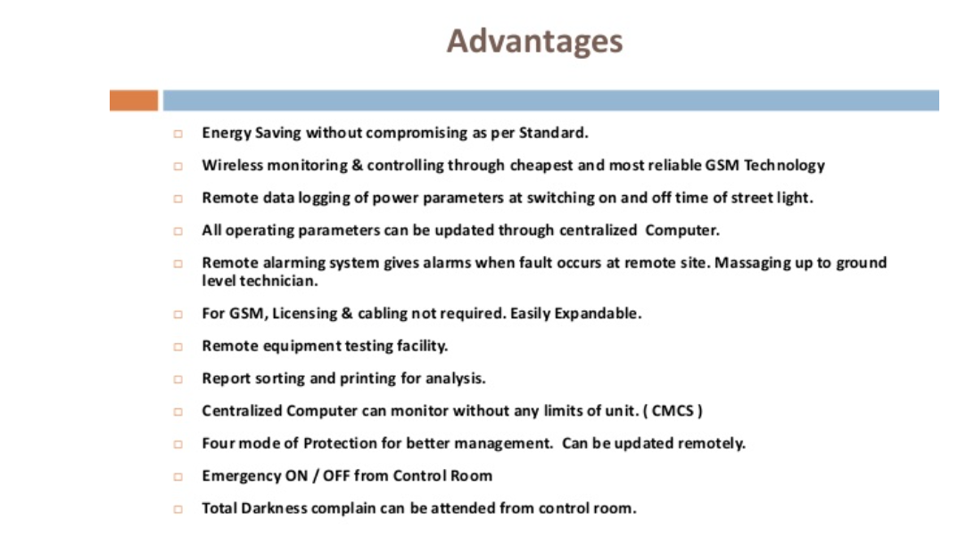

Slide 26
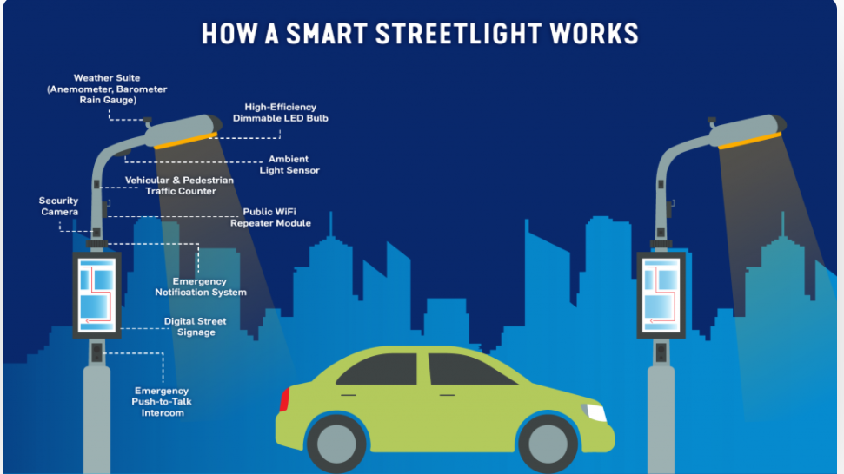
Research:-
The establishment of smart street lights in India has brought a lot of change to the country. On October 7th, 2019, a total of 1 million that is 10Lakh smart street lights have been installed across the country, which is a huge milestone as it saves 6.71 billion Kilo Watts which is huge. It also reduces the emission of 4.6 million tons of carbon dioxide that too every year, also nearly 13,000 jobs have also been created because of this project.

Slide 27
Future Works:
One of the main points of a system using cloud is that, the data gathered can be very useful for improving the system. The system can be made AI based, after a few years, for which this cloud data can turn out very helpful. The system can also be made to help in predicting the lifetime of the bulbs, improving efficiency of the system, getting better response times etc. The project is made taking into consideration the upcoming 5G technology and this would make the cost on installing routers redundant. Also helping in improving the connectivity of the system, which can also help additional features via the 5G, such as weather alerts, repair alters, location-based lighting system etc. The approach can also be used to find out other methods which might be cheaper and better than this design, which might improve the street light systems to a better level.

Slide 28
Conclusion:-
The project can be shifted dependent on the zone. There are various sorts of street lights. Street lights on the sides of a wide street, street lights in the focal point of a wide street, street lights on the finishes however substituting sides on a little street, etc. For every one of those kinds of street lights, it isn't important to know the heading in which vehicles are travelling. The project is applicable to a one sided road. Different approaches can be taken for different types of street lights and roads.
Therefore we have made the hardware part which is connected with the server and we can control the light ON/OFF through the system. The project works in both the ways, that is when there is a movement near the sensor the light gets ON, and OFF vice-versa during Night and can only manually controlled Morning, another way is that the entire data is shown in the website, that is how many lights are ON, which specific light is On, how many times, all the data is about Energy Savings have been displayed there.

Slide 29
Reference Research paper links
Base Paper Link:
Smart Lighting Systems for Smart Cities
March 2018 https://www.researchgate.net/publication/323560518_IoT-enabled_Smart_Lighting_Systems_for_Smart_Cities
Smart streetlights in Smart City: a case study of Sheffield
February 2021
https://www.researchgate.net/publication/349587224_Smart_streetlights_in_Smart_City_a_case_study_of_Sheffield
https://www.tvilight.com/wp-content/uploads/2019/06/Jaipur-Smart-City-Lighting-Tvilight-Case-Study.pdf
https://energy.economictimes.indiatimes.com/news/power/govt-eesl-to-install-10-lakh-led-lights-in-seven-andhra-districts/58999252
https://www.thehindubusinessline.com/news/national/eesl-to-retrofit-45-lakh-streetlights-in-hyderabad-ties-up-with-ghmc/article9748694.ece

